Slide 1
CHALLENGER
ROUND
John McConnell
1
THE IDEA
Local LLMs
of 5
Why it matters:
Using cloud-based LLMs is risky for our IP; code, content (e.g. RAG) , methodology, commercial, operational
Not to mention potentially quite costly
Proof point:
Harmonic Security’s 2025 analysis of GenAI use found that more than 4% of prompts and more than 20% of uploaded files contained sensitive corporate data. (Source: Axios)
THEME
Make it personal
AUDIENCE VOTE → Does this idea win the round?

Slide 2
Getting started with LM Studio
Run open-weight models on your own machine — no API keys, no data leaving your laptop or server
1
2
3
4
Install
Pick a model
Chat locally
Build with it
Download LM Studio for Mac, Windows, or Linux from lmstudio.ai
Browse the built-in catalog (Llama, Mistral, Qwen, Phi…) and download in one click
Open the chat tab and start prompting — runs fully offline on your GPU or CPU
Toggle the local server to expose an OpenAI-compatible API at localhost:1234
Why local? Privacy · zero cost per query · works offline · full control over the model

Slide 3
Local model scale
High-quality business analysis, robust coding frameworks, better instruction following, stronger writing quality
16-32GB RAM
By no means an exhaustive list of Local LLMs!
Qwen 2.5
0.5B
Phi-3 Mini
3.8B
Mistral Small
22B
Llama 3.1
70B
0.5B
10B
20B
30B
40B
50B
60B
70B
Gemma 2
2B
Qwen 2.5
32B
Frontier-level reasoning, sophisticated assistants, near cloud-quality outputs
64-256GB+ RAM (Multi GPU)
Llama 3.1
8B
Basic classification, keyword extraction, simple sentiment coding, short summaries
2-4GB RAM

Slide 4
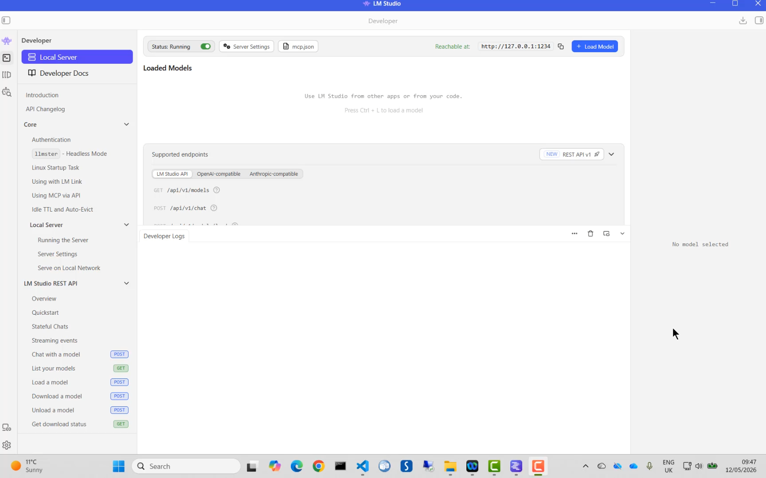

Slide 5
CHALLENGER
ROUND
John McConnell
4
THE IDEA
Model Context Protocols(MCPs) for survey research
of 5
Why it matters:
As we move more into Agentic AI they govern, specify and orchestrate the whole shebang
Proof point:
Without strong tool governance, agentic AI can become an enthusiastic junior analyst with admin rights. (or worse … MUCH WORSE)
THEME
Thinking big
AUDIENCE VOTE → Does this idea win the round?

Slide 6
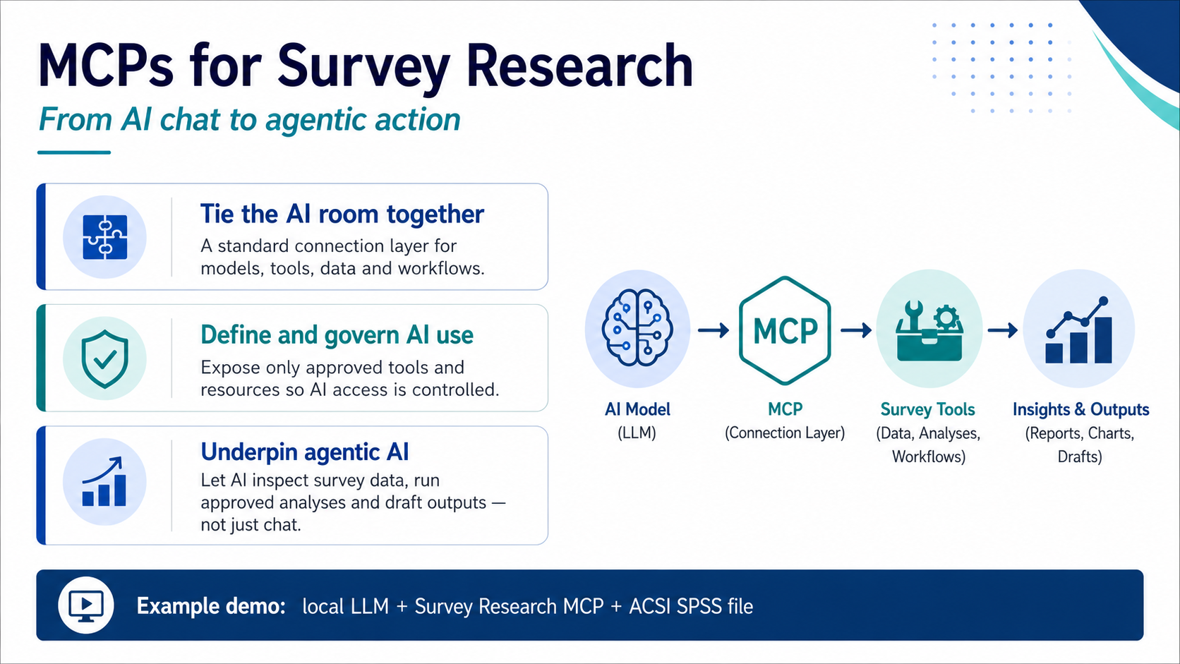

Slide 7
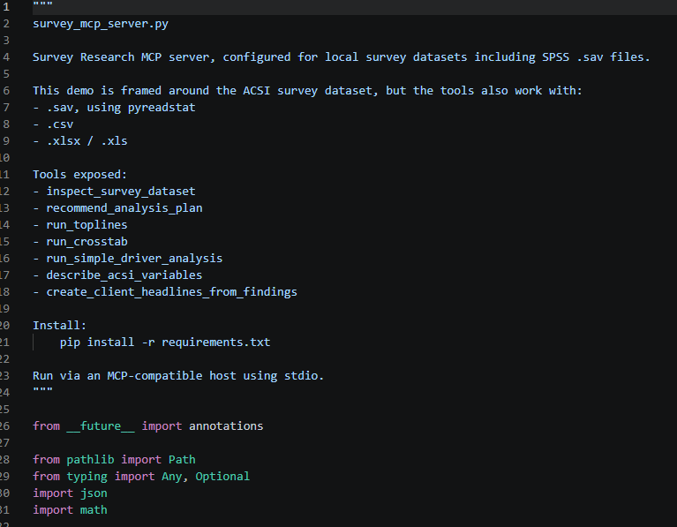

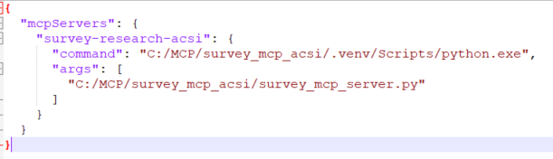
A simple MCP needs 3 things
The MCP Server code with all the specs/rules
An LLM
JSON to link the two together

Slide 8
